Slide 1
Safari.com Homework
Provided for Conversion Group
August 19, 2011

Slide 2
Contents
Who we are
Our Customers
Goals of partnership
Current analytics
Task

Slide 3
Who We Are

Slide 4
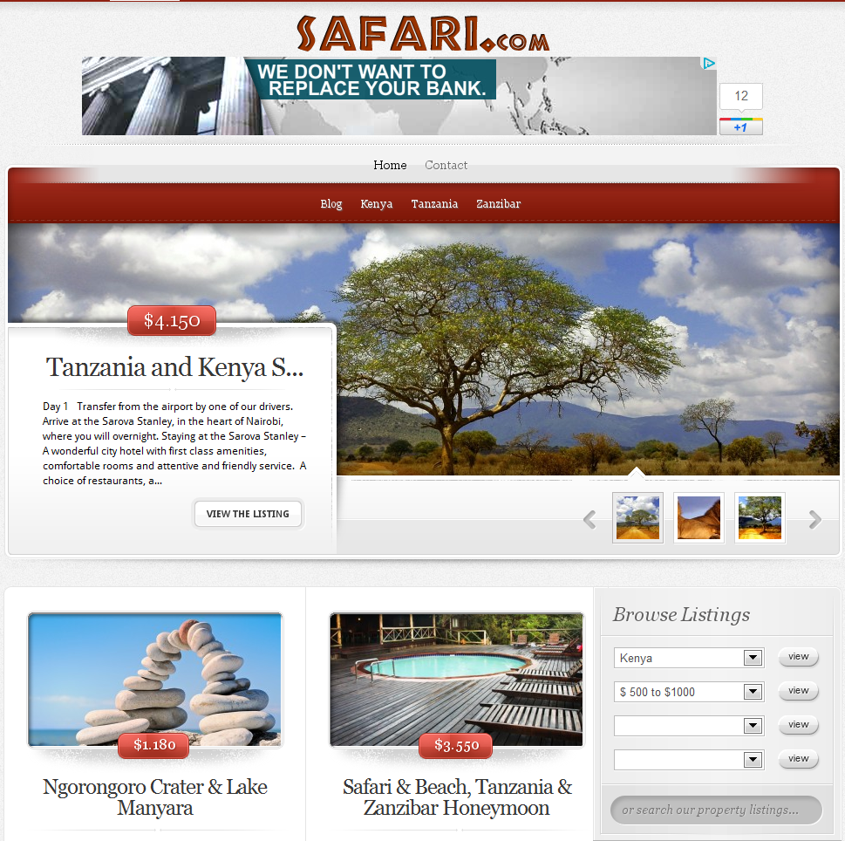
Who We Are
We are an affiliate website generating leads for ziarasafaris.com
We don’t sell vacations, but instead get paid for each lead we generate for Ziara Safaris
We get paid more for leads that turn into sales
We sell ads on our website, which accounts for 10% of our revenue

Slide 5
Who We Are
Most of the trips we sell have the following:
Private safaris
Custom itineraries
Quality safari vehicles
Expert staff and tour guides
Come with full meals and board
Reviews from trip advisor

Slide 6
Our Customers

Slide 7
Our Customers
Our target audience are people searching for safaris and travel information about Africa
Prices range from $2,000-$6,000 per person
Through surveys, we know they:
Like scrolling through images
Prefer full trip details
Have done extensive research

Slide 8
Goals of the Partnership

Slide 9
Goals of the Partnership
For us, it’s all about increasing revenue
Increasing leads is important, but increasing leads that convert are ideal
We’d like to increase profit to a point that we don’t need ads on our website, but taking them off essentially takes 10% of revenue away from us
We’ve removed the ads and have not noticed a difference

Slide 10
Goals of the Partnership
Beyond conversion, we have had an internal debate about how up front to be about ourselves being an affiliate
Do we convey ourselves as a “service” or “partner” of Ziara (full disclosure)?
Or do we design pages that make us appear as though we sell the vacations?
Either way, another goal is for visitors not to perceive us as just capturing their information

Slide 11
Goals of the Partnership
We would like to focus on our home page for most testing
This is the most prominent page
We think it needs a lot of work
We get most ad revenue from it

Slide 12
Current Analytics

Slide 13
Current Analytics
Visits – 67,000/month
Pageviews – 254,000/month
New/Returning – 92/8%
Bounce rate – 62%
90% organic traffic
Keywords:
African safari (trips/tours)
Tanzania safari
Kenyan safari

Slide 14
Current Analytics
Top content:
Index – 14,000/month
Kenya – 9,000/month
Tanzania – 10k/month
Zanzibar – 5k/month
Kenya in 1 week – 12k/month
Tanzania & Kenya – 11k/month
Contact and other safari pages account for the rest

Slide 15
Current Analytics
Top landing pages:
Index – 11,000/month
Kenya – 4,000/month
Tanzania – 5k/month
Zanzibar – 1k/month
Kenya in 1 week – 9k/month
Tanzania & Kenya – 7k/month
Blog and other safari pages account for the rest

Slide 16
Current Analytics
Top page views:
Index – 32,000/month
Kenya – 20,000/month
Tanzania – 19k/month
Zanzibar – 14k/month
Kenya in 1 week – 47k/month
Tanzania & Kenya – 36k/month
Blog and other safari pages account for the rest

Slide 17
Current Analytics
Top Conversion Pages:
Tanzania & Kenya – 1.6%
Best of Tanzania – 3.6%
Masai Mara & Lake Nakuru – 2%
Contact – 0.4%
Total site conversion – 0.9%

Slide 18
Current Analytics
Navigation Summary from home:
Rotating trip – 38%
Search box – 9%
Kenya – 7%
Tanzania – 6%
Zanzibar – 4%
Below the fold vacations – 20%
Tanzania Safaris (footer) – 3%

Slide 19
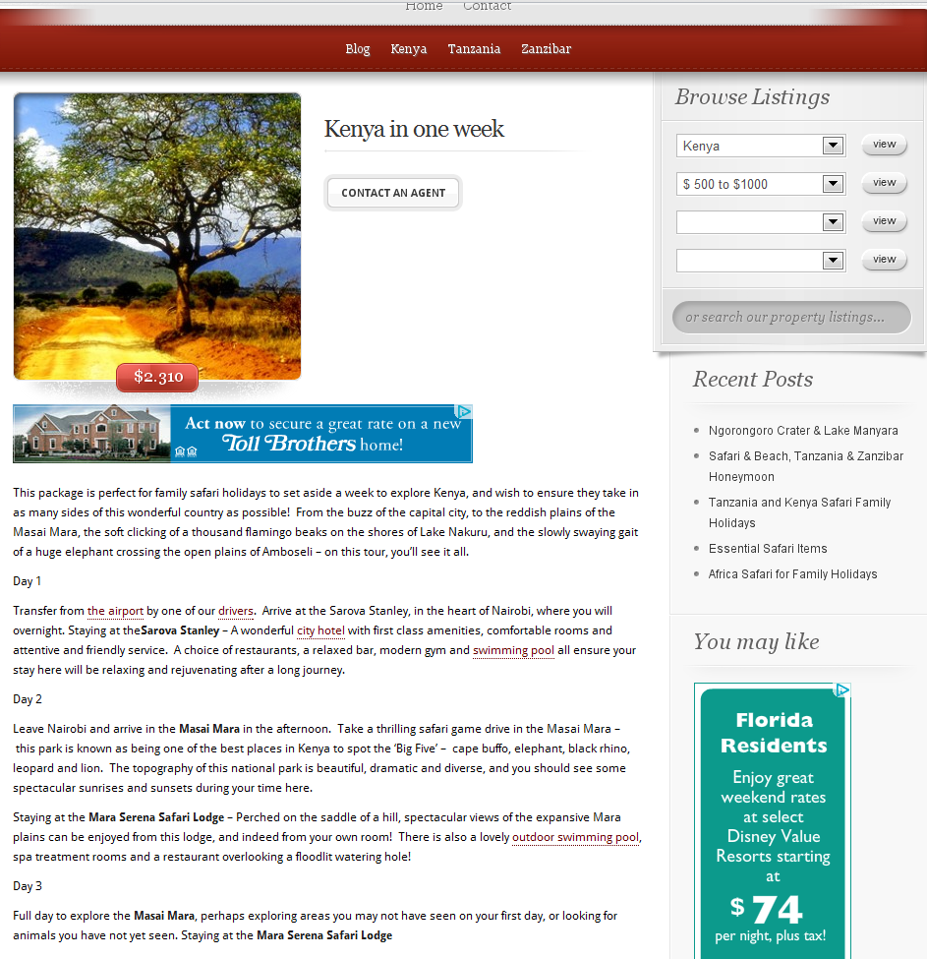
Current Analytics
Navigation Summary from Kenya in one week page:
28% - contact
18% - Search
17% - home
11% - Kenya
10% - Tanzania
4% - Zanzibar
2% - Blog

Slide 20
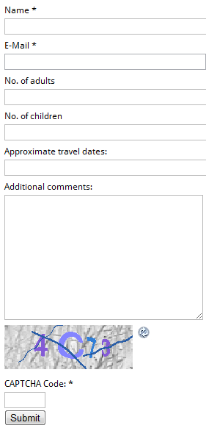
Current Analytics
Event Tracking:
Clicks on an image – 496,000
Form funnel (cumulative):
Name – 1,300
Email – 1,000
# of adults - 900
# of children - 850
Continued next page…

Slide 21
Current Analytics
Event Tracking:
Form funnel (cumulative):
Travel date – 250
Comments – 140
Captcha – 850
Submit – 603

Slide 22
Task

Slide 23
Task
Determine 6 tests draft test plan
For example
Test 1-2: Page a
Possible test variables include:
Xxxx
Yyyy,
Zzzz
Test 3-4: Page b

Slide 24
Task
Create 2 wireframes for first test
Best practices
Radical (complete categorical shift)
Include rationale behind treatments
Research question
What you intend to learn
Overall page strategy

